Slide 1
Human Factors and Return to Work
By Dr Manisha Shah &
Dr Ashike Choudhury

Slide 2
Content
To discuss return to work syndrome
Highlight specific areas where simulation can be useful
To discuss future pathways to implement simulation based return to work support.

Slide 3
Return to Work Syndrome
“Re-entry: major event or transition between one reality and another.
anxiety, fear, apprehension, dread, and unease.”

Slide 4
Emotional burden
Carer’s leave
Illness
Mental health
Child care
Financial worries

Slide 5
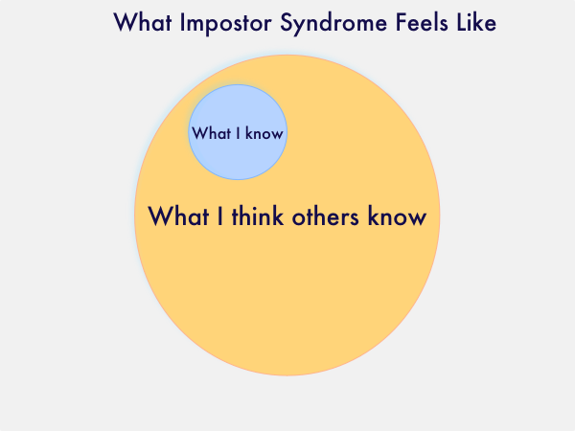
Imposter syndrome :
A phenomenon where high-achieving individuals are plagued with an inability to embody their accomplishments and are haunted by thoughts and fears of being found out as a “fraud.”
Feedback
Mentoring

Slide 6
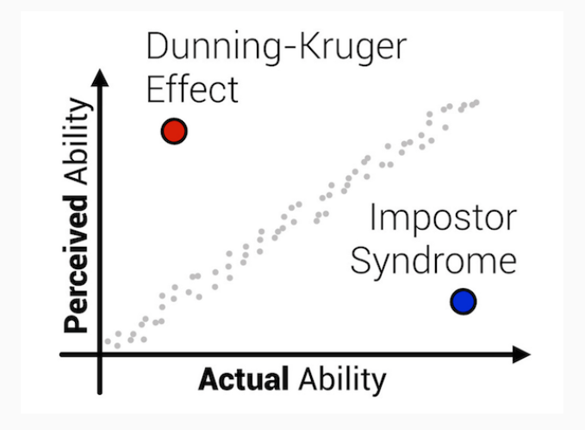

Slide 7
Confidence crisis
Pre-return Confidence and Competence questionnaire?

Slide 8
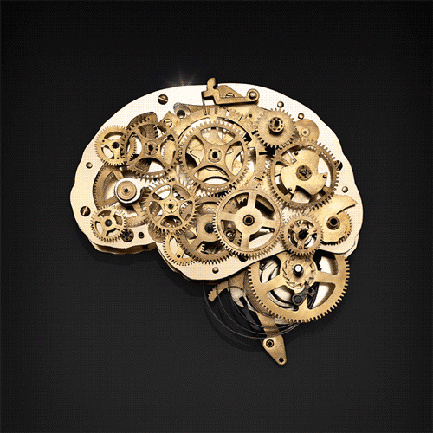
Knowledge and skill decay.

Slide 9
Knowledge
What can be done to improve knowledge gaps while away?
Policies / Protocols
Landmark paper published
E learning
Green book

Slide 10
Skill Decay

Slide 11
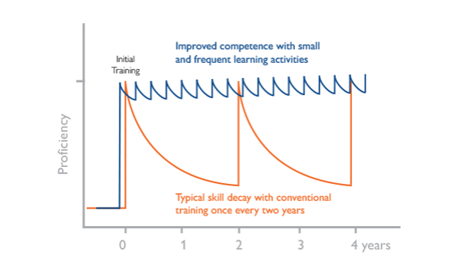

Slide 12
Amount of time away
More complex skill
Requiring more complex decision making
D’Angelo, A. L., Ray, R. D., Jenewein, C. G., Jones, G. F., & Pugh, C. M. (2015). Residents’ perception of skill decay during dedicated research time. Journal of Surgical Research, 199(1), 23-31.

Slide 13
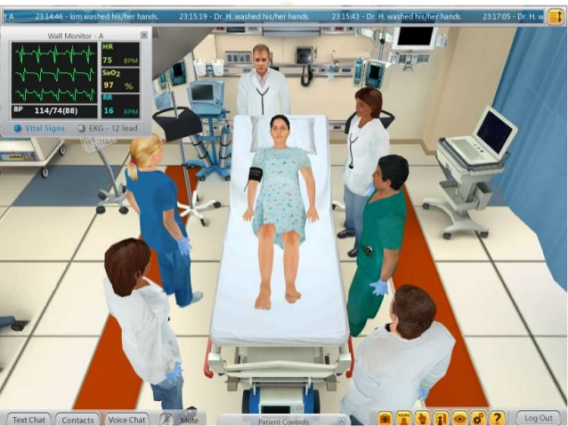
Role of Simulation
Simulation is a valuable tool that allows us to identify areas for improvement and expose potential errors that may occur during complex presentations of basic procedures.
Which skills do you think simulation can help your trainees with?

Slide 14
Decision Making
Cognitive scenarios
Situation awareness
Effective communication
Team leadership
Delegation

Slide 15
“General surgery research residents' intraoperative leadership skills showed significant correlations to their perceptions of skill decay and task difficulty during a bowel repair” (Gannon s. et al. 2016).

