Slide 1
MTI for Overseas Physicians
Dr Manisha Shah: Simulation Lead and Consultant Anaesthetist
Gemma Wrighton:Clinical Simulation Manager
Dr Katherine Smith: Simulation Deputy Lead and Acute Medicine Consultant
Dr Rahul Sarkar: Intensive Care and Respiratory Consultant
Dr Ashike Choudhury: Emergency Medicine Consultant

Slide 2
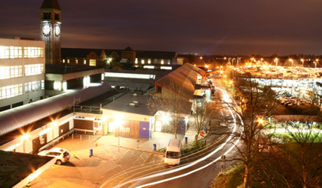
Background
75% of medical registrar rota EMPTY
Registrars on call REDUCED from 4 to 3 per 24 hours
Agency staff COST £15,656/slot/month
Vs
Substantive registrar £5702/slot/month
GMC Survey raised concerns of INCREASED PRESSURE and WORKLOAD

Slide 3
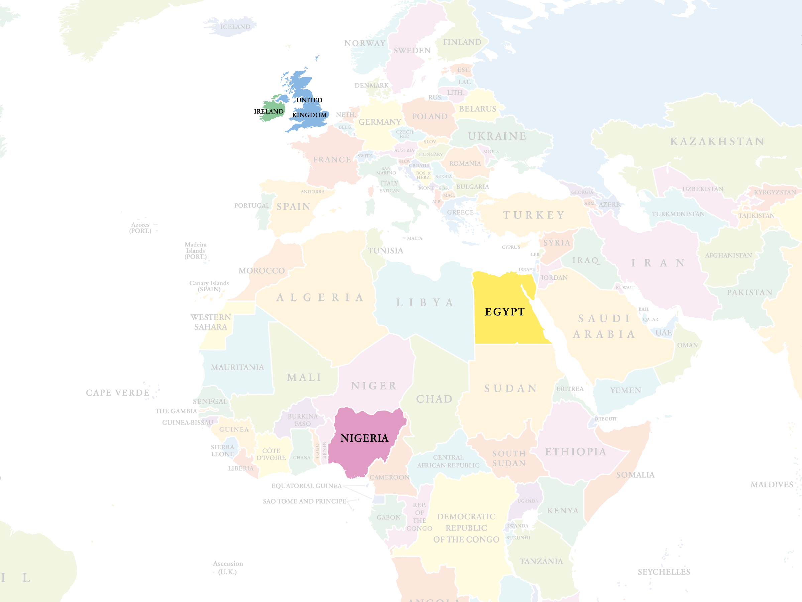
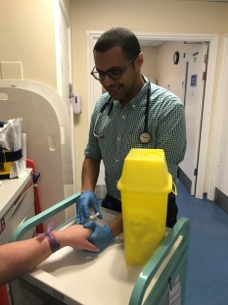
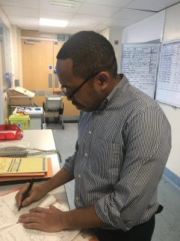
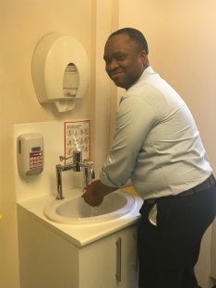
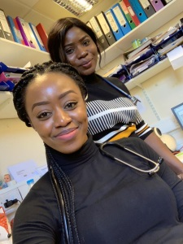

Slide 4
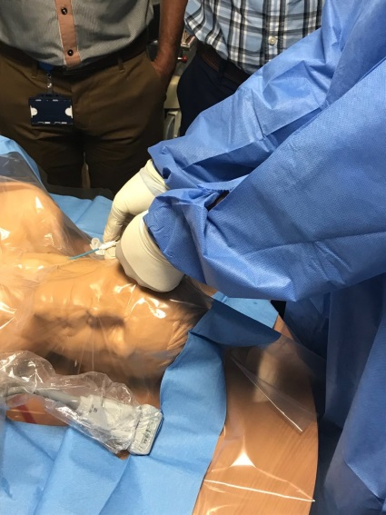
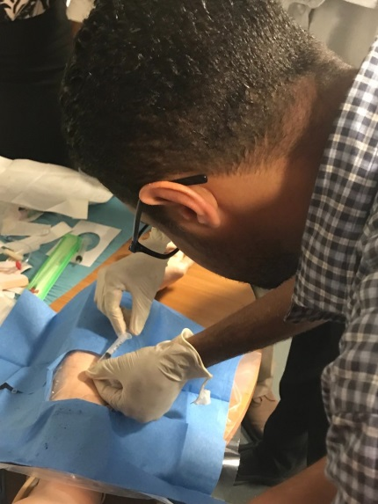
Programme SPORTT Supported Programme of Return to Training
1. Resilience Workshop
2. Skills Training
3. High Fidelity Simulation
4. Hybrid Simulation
5. Resilience Training
Notes:
Local costs to run the course is: £1942.50 over the set 5 days.
The Resilience workshop and training sessions were run by our Consultant Psychiatrist Katina
The Skills training session: ITU and Acute Medicine consultants
High fidelity simulation and hybrid session is run by consultant anaesthetist and simulation lead.
Skills such as chest drain, CVC and arterial line insertion, paracentesis and Lumbar puncture.
Resilience workshop allowed the MTI’s to address any concerns, worries, difficulties that they were facing with coming into the new environment of the NHS and the UK. Following this session the took part in resilience training, this gave them various tools to utilise to reduce the stress and anxiety that they may initially of faced to enhance their experience here at Medway.

Slide 5
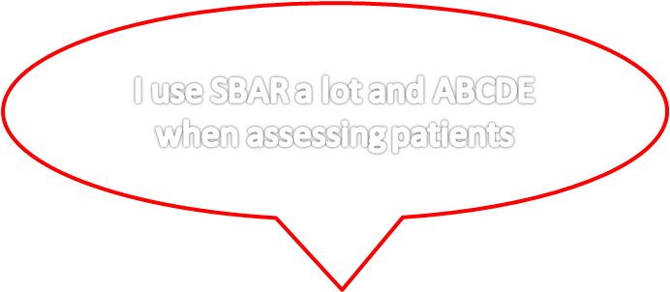
The course is very beneficial. All new doctors should have a feel of this course and it should be done early on joining the Trust.
I use the leadership and managed working skills in my daily activity.
Could it be arranged more frequently?

Slide 6
Workforce Analysis

Slide 7
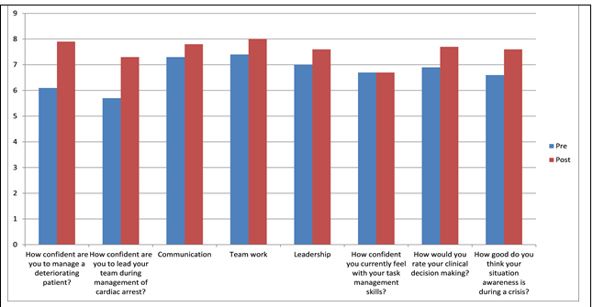
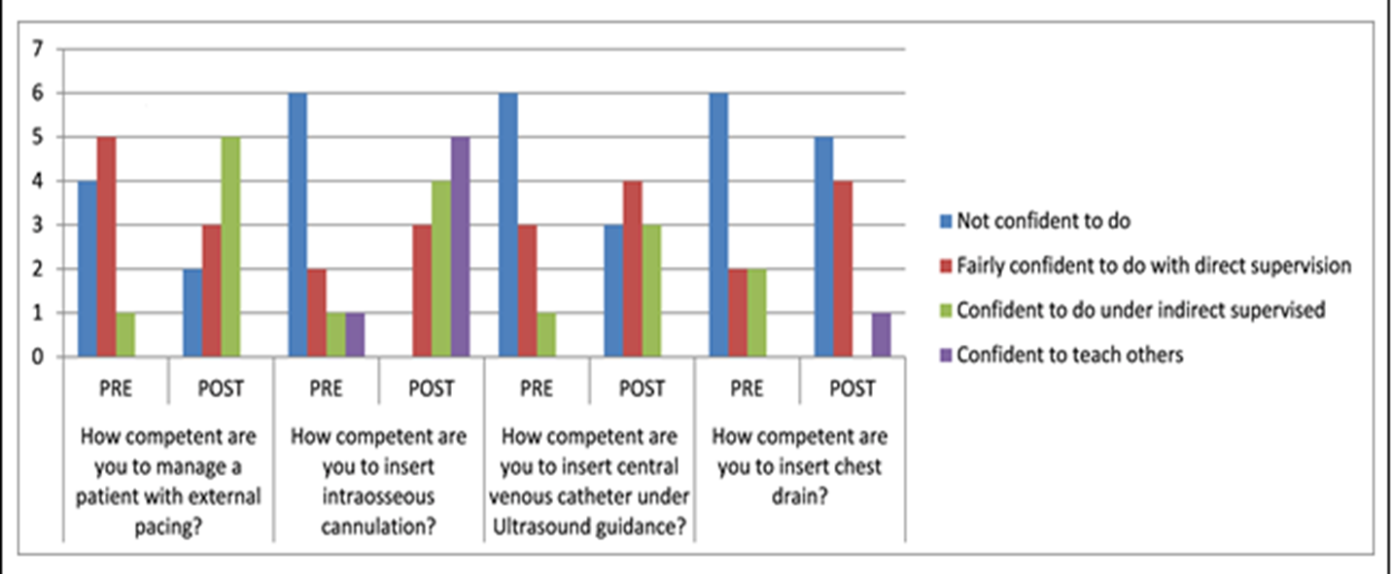
Confidence & Competence
Notes:
Abdullah talking about personal benefit supported by graphs of his colleagues educational value

Slide 8
Developments…..
The Medical registrar rota is FULL
Registrars on call REDUCED from 4 to 3 per 24 hours
75% of medical registrar rota EMPTY
There a 4 registrar’s on call everyday
Financial
Costs
Reduced by
50%
Agency staff COST £15,656/slot/month
Vs
Substantive registrar £5702/slot/month
Trainees of all levels expressing that workload and pressure is more manageable
GMC Survey raised concerns of INCREASED PRESSURE and WORKLOAD
Notes:
Add the savings details on slide

Slide 9
Full capacity SpR rota
Potentially avoidable in-hospital cardiac arrests fell by 53% (2017 vs 2018)
CQC July 2018
Improvements in the management of the deteriorating patient and sepsis.’
‘Examples of outstanding care in urgent and medical care.’
Trainee Education and Welfare
2. Patient Safety
3. Financial Impact
Empowerment
Understanding NHS
Sources of support
Roles
Resilience
Integration
Technical and non-technical skills
Course cost £1,942.50 (max 10 candidates/course)
Average savings on SpR rota £110,000/month

Slide 10
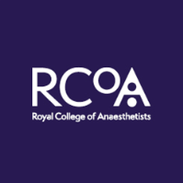
Future
NHS
SPORTT is integrated into regular simulation training for CMT/ACCS/MTI.
Royal College of Anaesthetists training group have plans to implement for all MTI trainees.
Nigeria: supporting MTI to introduce simulation to medical training.
Sri Lanka: anaesthetists have approached Medway to visit and support development for their trainees.

Slide 11
