Slide 1
The Deteriorating Patient Assessment
By Dr Danny Lamdin

Slide 2
Overview
A deteriorating patient is something most of us will frequently come across both on call and in A&E.
It can be very daunting when first assessing these patients and you may not know where to start.
Here are some tips on how to identify, asses, and manage a deteriorating patient.

Slide 3
Identification
NEWS
National Early Warning Score
Provides early identification of deteriorating patients
Allows appropriate escalation to medical teams and seniors

Slide 4
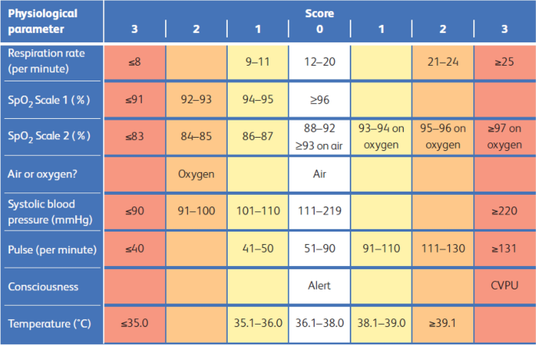
Identification
This is an example of a NEWS chart.
Patients with an increasing score or a high score in a single area may be at risk of deterioration and should be urgently assessed and escalated appropriately

Slide 5
Identification
NEWS
National Early Warning Score
Provides early identification of deteriorating patients
Allows appropriate escalation to medical teams and seniors
Nursing Concern
Relative Concerns

Slide 6
Assessment and Intervention
A – Airway
B – Breathing
C – Circulation
D – Disability
E – Exposure
Re-assess

Slide 7
Assessment and Intervention
Deteriorating patients should be assessed using an A-E approach
You should perform and complete assessment and ensure frequent re-assessment
Treat life-threatening problems before moving on
Reassess after ANY intervention
Call for help early
The aim is to prevent further deterioration in the patient's condition to buy time until specialist help arrives
We will review the A-E assessment and consider some interventions you may implement

Slide 8
Initial Assessment
Is the patient conscious and breathing normally?
If yes, continue with the assessment
If no, assess respiratory effort and feel for a carotid pulse. If these are absent put out a cardiac arrest call and start CPR
End of the bed – do they look immediately unwell to you?
Ensure monitoring equipment is available and attached to the patient
Obtain a full set of vital signs

Slide 9
Airway – Assessment
Ask “Are you alright?” – if the patient is able to verbally respond this indicates a patent airway
Are there signs of obstruction?
Partial – Reduced air entry/Noisy breathing/Stridor
Complete – See-saw respiration (paradoxical chest and abdominal movement)/Central cyanosis/No breath sounds at nose or mouth
Inspect the mouth for obstructions such as foreign bodies and secretions

Slide 10
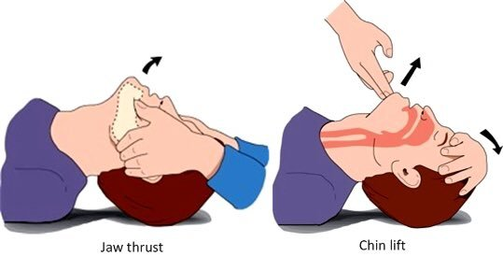
Airway – Interventions
Call for help (via 2222) – airway obstruction is an emergency
Airway Manoeuvres
Head tilt chin lift
Jaw Thrust
Airway Adjuncts
Oropharyngeal
Nasopharyngeal airway
Tracheal intubation
Treat cause – if a specific cause is identified attempt to treat (e.g. Blood/Vomit/Secretions should be suctioned, Anaphylaxis treat with IM adrenaline)

Slide 11
Breathing – Assessment
Respiratory rate – normal 12-20
Causes of Bradypnoea – sedation, opioid toxicity, raised ICP, CO₂ retention
Causes of Tachypnoea – airway obstruction, asthma, pneumonia, pulmonary embolism, pneumothorax, pulmonary oedema, heart failure, anxiety
Oxygen saturation – aim >94% unless at risk of hypercapnic respiratory failure, then aim 88-92%
General signs of respiratory distress – sweating, cyanosis, accessory muscle use, abdominal breathing, cough, stridor
Assess breath depth, breathing pattern and symmetry of chest expansion

Slide 12
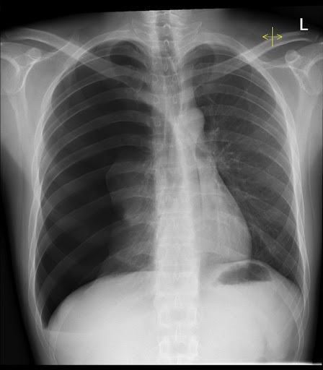
Breathing – Assessment
Percuss the chest – Pneumothorax (hyper-resonant), Consolidation/Pleural effusion (dull)
Chest Auscultation – assess for wheeze, crepitations and/or reduced or absent breath sounds
Assess the position of the trachea
Arterial blood gas (ABG) is important in identifying patients with type 2 respiratory failure who may require escalation sooner
Chest X-ray
What does the X-ray on the right show?
Tension Pneumothorax

Slide 13
Breathing – Interventions
Supplementary Oxygen
Initially high flow and then wean as appropriate according to response
Assisted Ventilation
If inadequate/absent ventilatory effort use a bag-valve-mask or insert a laryngeal mask and manual ventilate the patient
Non-invasive ventilation may be appropriate for some patients
Some patients may require tracheal intubation, so it is important to call for help as early as possible
Treat the cause
Treat immediately life-threatening conditions such as acute severe asthma, pulmonary oedema, and tension pneumothorax

Slide 14
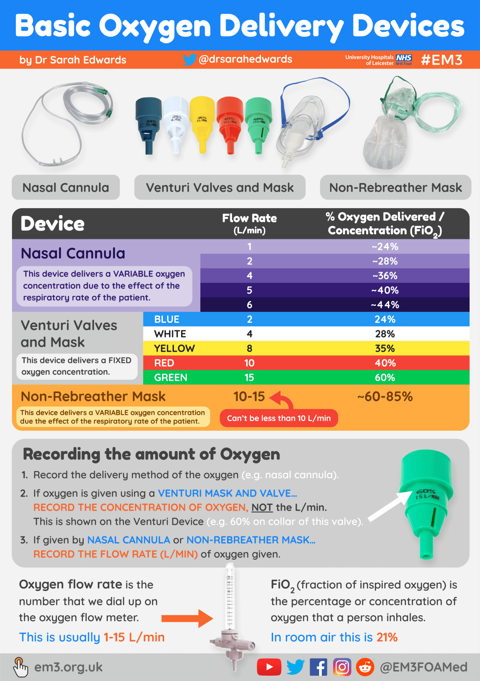

Slide 15
Circulation – Assessment
Vitals – Heart rate, Blood pressure, Capillary refill
Pulse
Peripheral and Central – peripheral pulse may not be palpable in hypotension
Rate, Rhythm, Character, Volume
Heart Auscultation
Signs of reduced cardiac output – peripheral cyanosis, cool peripheries, reduced consciousness, oliguria (urine output <0.5mL/kg/hr)
Assess for external haemorrhage
ECG
What arrhythmia is shown in the ECG?
Ventricular Tachycardia

Slide 16
Circulation – Interventions
Ensure vascular access and take blood
FBC, U&Es, LFTs, CRP, Coagulation, Blood cultures, VBG +/- ABG
Other tests to consider: Troponin, D-dimer, Bone profile
IV Fluids
If Hypotensive give stat IV Crystalloid (e.g. Hartmanns, Normal Saline) - 500mL over 15 mins, reduce to 250mL if history of cardiac failure. Reassess response to fluids after each bolus and repeat if required
If Hypotensive with signs of cardiac failure seek urgent specialist input
Consider the need for blood transfusion in haemorrhage
Treat cause
Common conditions in deteriorating patients include ACS, hypovolaemic shock, septic shock, and arrhythmias

Slide 17
Disability – Assessment
GCS (Eyes – 4, Verbal – 5, Motor – 6)
ACVPU – Alert, Confused, responds to Voice, responds to Pain, Unresponsive
Pupils – size, symmetry, reaction to light
Capillary blood glucose
In peri-arrest patient this can be obtained from the VBG/ABG
Check the drug chart

Slide 18
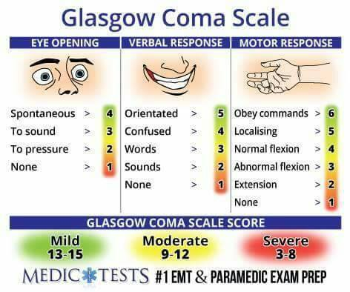

Slide 19
Disability – Interventions
Common causes for unconsciousness include hypoxia, hypercapnia and cerebral hypoperfusion which should have been identified and managed already in the assessment
Hypoglycaemia (glucose <4mmols/L) – 150mL 10% Glucose IV over 15 mins OR 1mg Glucagon IM
Drugs/Overdose
Medication overdoses may lead to patients becoming drowsy and unresponsive and may reduce the respiratory rate, a common cause for this is opioid toxicity
Treat opioid toxicity with Naloxone 400mcg IM/IV

Slide 20
Exposure – Assessment
Measure temperature if not done so already
Complete the examination by fully exposing the patient while maintaining their dignity
Look for rashes, drains, catheters, wounds
Abdominal examination
Examination of the limbs for pain, swelling or deformity
Take a full history from the patient (if possible), relatives, carers and other staff
Review recent notes, vital signs, investigations and medications

Slide 21
Next Steps
Once you have performed a complete assessment go back to A and start again
Assess response to treatment and change in clinical condition
Repeat treatments where appropriate
Treat the underlying cause where identified and possible
Handover to the appropriate team using SBAR technique
Document assessment and plan

Slide 22
Key Points
Follow a systematic A-E
Ensure you complete a full assessment
Treat life-threatening problems as you go
Reassess regularly
Call for help early – this can be to your seniors or if necessary call 2222

Slide 23
Further Resources
Mind the Bleep – Managing the Deteriorating Patient Video
Quite a long video but goes into more detail around assessing and managing deteriorating patients, ABG interpretation and escalating concerns
https://youtu.be/I_1QdvdR2tg?si=kO66LxLU_nv8fYBS
Teach me Surgery – A to E Assessment of the Acutely Unwell Patient
Shorter video with a surgical focus but still provides a good overview of initial assessment and interventiosn
https://youtu.be/v_jsPhjJQVk?si=EREdLzu9WxgPmk_3

Slide 24
References
Resuscitation Council (UK) – ABCDE Approach. Available at: https://www.resus.org.uk/library/abcde-approach
Geeky Medics – ABCDE Assessment – OSCE Gudie. Available at: https://geekymedics.com/abcde-approach/
East Midlands Emergency Medicine Educational Media. Available at: https://em3.org.uk/posters-and-infographics

