Slide 1
Sustainability in Healthcare
By Dr Danny Lamdin

Slide 2
Aims and Objectives
Understand
Understand the contribution of healthcare systems on the environment
Recall
Recall practical steps to improve sustainability in the workplace
Consider
Consider how you can change your practice to improve sustainability

Slide 3
Background
Climate change has been described by some as the biggest health threat worldwide of the 21st century
Increasingly, long-term illnesses are triggered by air pollution and communities living in disaster zones due to climate change
Global healthcare sector's carbon footprint is equivalent to 4.4% of global net emissions (2 gigatons of CO2)
If the health sector was a country it would be the 5th largest emitter
Almost 2x more than the aviation injury
Notes:
https://www.bmj.com/content/366/bmj.l5560?sso=
https://www.theguardian.com/care-means-the-world/2023/dec/22/sustainability-in-healthcare-the-impact-of-the-health-sector-on-the-environment

Slide 4
Healthcare Carbon Emissions
3 biggest emitters contribute 56% of total healthcare carbon footprint – US, China, EU
Top 10 emitters make up 75% of global health care climate emissions
United states is the largest emitter of health care carbon in both absolute terms and per capita
NHS is responsible for 4% of England's total carbon emissions
And 40% of public sector emissions
Transport – 3.5% of all road travel in England relates to patients/visitors/staff/suppliers to the NHS
Notes:
https://noharm-global.org/sites/default/files/documents-files/5961/HealthCaresClimateFootprint_092319.pdf

Slide 5
Where does this carbon come from?
Notes:
https://noharm-europe.org/content/global/health-care-climate-footprint-report - page 22

Slide 6
Healthcare’s Carbon Footprint
17% of global healthcare’s carbon footprint comes directly from healthcare facilities
12% comes from indirect emissions from purchased electricity, steam, cooling, and heating
71% primarily from the healthcare supply chain
From all of these sources, >50% of the health sectors emissions footprint is due to energy use
Other significant contributors: agriculture (9%), pharmaceuticals and chemicals (5%), transport (7%), waste treatment (3%), anaesthetic gases (0.6%), and inhalers (0.3%)

Slide 8
Where does this carbon come from in the NHS?
Notes:
https://www.england.nhs.uk/greenernhs/wp-content/uploads/sites/51/2022/07/B1728-delivering-a-net-zero-nhs-july-2022.pdf - page 14

Slide 9
Why does this matter?
Climate change can have a significantly negative impact on health in a multitude of ways
Impacts on health include:
Pulmonary and Cardiovascular conditions form air pollution
Death and illness from increasingly frequent extreme weather events
Malnutrition – disruption to food systems
Food/Water/Vector-borne disease
Mental health issues
As with most impacts from climate change these are disproportionately felt by the most vulnerable
2030-2050, climate change is expected to cause 250,000 additional deaths annually from undernutrition, malaria, diarrhoea and heat stress
Notes:
https://www.who.int/news-room/fact-sheets/detail/climate-change-and-health#:~:text=Climate%20change%20is%20impacting%20health,diseases%2C%20and%20mental%20health%20issues.

Slide 10
Notes:
https://noharm-europe.org/content/global/health-care-climate-footprint-report - page 11

Slide 11
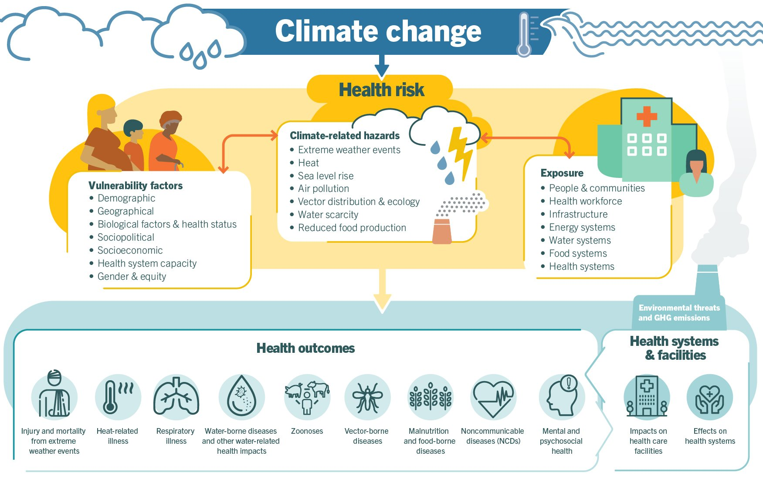

Slide 12
What's being done?
NHS has set a target to be net zero by 2040 for direct emissions
These targets are based on analysis of current and planned NHS activities, and include assumptions about future innovations
Greener NHS programme aims to help reach this target

Slide 13
Decarbonising the NHS
Estates and Facilities
Reducing emission from building/repair - use of low-carbon materials
Upgrading hospital buildings/facilities
Optimise NHS building use
Onsite renewable energy and heat generation
Medicines
Reduction in emissions involved in manufacturer of medicines
Optimise prescribing
Substitute medications for low carbon alternatives (e.g. swap anaesthetic gases for TIVA)
Improve waste processes

Slide 14
Decarbonising the NHS
Travel and Transport
Zero-emission vehicles
Reducing unnecessary journeys
Encourage active forms of travel
Supply Chain
More efficient use of supplies
Low-carbon substitutions
Product innovation
Ensuring suppliers decarbonise their processes

Slide 15
What can you do?
Avoid
Unnecessary investigations – e.g spine x-ray for uncomplicated back pain
Unnecessary treatments - e.g. trial lifestyle interventions before pharmacological for insomnia
Unnecessary PPE – e.g. do not wear gloves if there isn't exposure to bodily fluids
Low Carbon Alternatives
Encourage patients to use pills where possible rather than liquid medications (less waste, longer shelf life)
Switch from IV to oral as soon as possible
Reuse
Use reusable PPE and equipment where possible
Notes:
https://sandpit.bmj.com/graphics/2023/tangibleActions-v8/

Slide 16
What can you do?
Reduce
Reduce unnecessary medication use (e.g. reduce unnecessary PPI where possible)
Promote social prescribing
Optimise medication dosing – e.g. switch to OD dosing of oral iron supplements
Reduce routine inpatient blood testing
Rationalise surgical equipment sets
Reduce unnecessary RBC transfusion
Reducing/Substituting use of Nitrous oxide
Notes:
https://sandpit.bmj.com/graphics/2023/tangibleActions-v8/

Slide 17
Further Reading
If you would like more information on sustainable healthcare including how to build a net zero NHS, and how to incorperate sustainability into quality improvement projects you can review 'Environmental Sustainability Healthcare Programme' e-learning on elfh
https://www.e-lfh.org.uk/programmes/environmentally-sustainable-healthcare/

Slide 18
References
Bosurgi R. Climate crisis: healthcare is a major contributor, global report finds BMJ 2019; 366 :l5560 doi:10.1136/bmj.l5560
Healthcare Climate Footprint Report by Healthcare without harm
Deliver a 'Net Zero' National Health Service by NHS England
Climate change by World Health Organisation. Available at: https://www.who.int/news-room/fact-sheets/detail/climate-change-and-health#:~:text=Climate%20change%20is%20impacting%20health,diseases%2C%20and%20mental%20health%20issues
Tangible Actions for Sustainable Healthcare by BMJ. Available at: https://sandpit.bmj.com/graphics/2023/tangibleActions-v8/

