Slide 1
Falls Assessment
An overview of why patients fall, how we assess them, and how we can prevent it
By Dr Danny Lamdin

Slide 2
Aims and Objectives
To provide an overview of risk factors and consequences of falls
Be able to take a history following a fall
Assess the unwell patient after a fall
Identify significant injuries following a fall
Consider the need for imaging following a fall

Slide 3
Background
Significant problem in the UK and worldwide - >240,000 inpatient falls annually
30% of >65y/o fall at least once per year
This increases to 50% in over 80y/o
You may see patients in ED or on the wards who have fallen
Notes:
A fall is defined as an event which causes a person to, unintentionally, rest on the ground or other lower level - NICE Falls Risk Assessment - https://cks.nice.org.uk/topics/falls-risk-assessment/

Slide 4
Definitions
Fall – unexpected event in which a person comes to the ground or other lower level with or without loss of consciousness
Slip – to slide accidentally causing the person to lose their balance. This is either corrected or causes the person to fall
Trip – to stumble accidentally, often over an obstacle causing the person to lose their balance. This is either corrected or causes the person to fall
Syncope – transient, self-limiting loss of consciousness. This can be subdivided into cardiac syncope and vascular syncope

Slide 5
Risk Factors
History of falls
Conditions Affecting Mobility/Balance (e.g. Arthritis, Stroke, Syncope, Parkinson’s)
Muscle weakness
Poor balance
Visual impairment
Cognitive impairment
Depression
Alcohol misuse
Polypharmacy
Environmental Hazards (e.g. Poor lighting, uneven surfaces, poor footwear)

Slide 6
Why does it matter?

Slide 7
Complications
Falls are the main cause of injury, injury related disability, and death in older people
Common complaint in ED
Common call on ward cover for inpatients
Linked to significant injury including traumatic brain injury, severe lacerations, and fractures
Cause considerable pain and distress
Contribute to reduced quality of life, loss of independence and functional decline
>50,000 femoral fracture in England and Wales in 2021, 2,006 of these occurred in an inpatient setting

Slide 8
Assessment
There will be variations in your assessment as it will need to be tailored to the specific patient you are seeing
However, for most patients, much of the points discussed here will apply, both to inpatients and those presenting to the Emergency Department
Importantly, if you are unsure what to do or concerned about a patient ESCALATE to a senior
As with most patients, quickly assess A-E to ensure they are stable – if safe to do so conduct a complete history and examination

Slide 9
History
What
Before
Warning/Prodrome? Preceding symptoms, including dizziness/chest pain/palpitations/light-headedness?
During
Loss of consciousness? Head injury?
Incontinence/Tongue biting – may suggest seizure
Pallor/Flushing – may suggest vasovagal episode
First body part to hit the floor?
After
What happened? Able to get up by themselves? Length of time on floor? Able to resume normal activity after?
Post-fall symptoms – e.g. confusion, reduced GCS, Speech difficulty/weakness/paraesthesia
Distance fallen (e.g. from standing)? Head injury? Other injuries from fall?.

Slide 10
History
When?
When did the fall happen? Time of day? Activities they were doing at the time?
Where?
Inside vs Outside?
Inpatient?
Why?
Why do they think they fell? Collapse vs Trip vs Syncope?
How (many)?

Slide 11
History
Witnessed vs Unwitnessed – collateral history from witnesses?
Important to establish baseline to identify new changes in mental status/functional ability
Past medical history – consider predisposing conditions (e.g. CV disease, Arrhythmias, COPD, Parkinson’s, Peripheral neuropathy, Stroke, Dementia, Incontinence)
Social History – Alcohol use, Support at home, Mobility (including normal mobility aids)

Slide 12
History
Medication Review
Consider predisposing medications – e.g. Beta-blockers (bradycardia), Diabetic medications (hypoglycaemia), Antihypertensives (hypotension), Benzodiazepines (sedation), Antibiotics (current infection)
Systems Review (Pre-, During, Post)
Chest pain, Palpitations
Shortness of Breath, Cough
Loss of consciousness, Seizures, Motor/Sensory disturbance
Incontinence, Urgency, Dysuria
Abdominal pain, Diarrhoea, Constipation
Joint pain, Muscle weaknesses

Slide 13
Examination
A-E
Assess the patient according to Airway, Breathing, Circulation, Disability, and Exposure
Treat any life-threatening findings on assessment
Escalate early
Check for head, spine and hip injuries prior to moving the patient
Use trust post-falls checklist and documentation
Examination will need to be tailored to the specific patient and the circumstances of their fall, however today we will list the minimum requirements for post-falls assessment

Slide 14
Head and Neck Assessment
If signs of a head injury consider the need for CT Head and ensure regular neurological observations.
In suspected neck injury maintain in-line immobilisation until equipment available and seek senior support.
While awaiting support continue to assess A-E including regular observations.

Slide 15
Specific Examinations
Respiratory – increased work of breathing, features of infection or pulmonary oedema?
Cardiovascular
Pulse – regular vs irregular, tachy vs brady
BP, Heart murmurs, Carotid bruit
Neurological
Cranial nerve examination – Stroke, Visual impairment
Power/Tone/Reflexes/Sensation/Co-ordination
MSK – check for injuries associated with fall (special attention to points making contact with the floor)

Slide 16
Examinations to consider
Timed Up & Go Test
Time person getting up from chair without using their arms, walk 3 meters, turn, return to the chair, and sit down
If person usually uses walking aid this can be used in the test
Observe postural stability, gait, stride length, and sway
Score of 12-15 seconds or more indicates high risk of falls
Turn 180º Test
Ask patient to stand and step around until they are facing the opposite direction
More than 4 steps indicates the need to consider further assessment

Slide 17
Investigations
Used to identify cause, these will vary depending on context of the fall and examination findings
Essential Investigations
Lying Standing Blood Pressure
ECG, Urine dipstick, Cognitive screen, Blood glucose
VBG, FBC, U&Es, CRP, LFTs, Bone profile, Clotting (if nil recent bloods if inpatient)
Chest x-ray
Optional Examinations
CT Head
X-ray if suspicion of fracture

Slide 18
Doctor Review Protocol
Painful hip/clinical signs of any fracture OR moderate harm fall – doctor review in 30 minutes
Head injury with GCS <13 on initial assessment or reducing – urgent doctor review
Head injury with stable GCS – doctor review within 2 hours
Witnessed fall with no/low harm and no head injury – doctor review within 12 hours

Slide 19
Head Injury
If a patient sustains a head injury following a fall they may need undergo prolonged observation and may require imaging
Neurological Observation Post-Fall:
Every 30 minutes until GCS 15 achieved
Minimum frequency of observations of patients with GCS 15 after initial assessment
Every 30 minutes for 2 hours
Then hourly for 4 hours
Every 2 hours after until further review

Slide 20
CT Head Criteria
NICE have clear guidelines on which patients should receive a CT Head following a presentation to ED with a head injury after a fall
For inpatients many of the features may be similar but if you are concerned you should discuss patients with your senior to establish whether imaging is required
Important factors to consider are GCS and neurological observations post-fall, bleeding disorders, use of anticoagulants and antiplatelets, patient’s age, post-fall vomiting, signs of a basal skull fracture, or focal neurological deficit
The algorithm is included in the following slides
There is a similar algorithm covering the need for CT Cervical spine

Slide 21
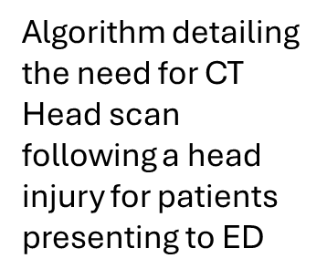

Slide 23
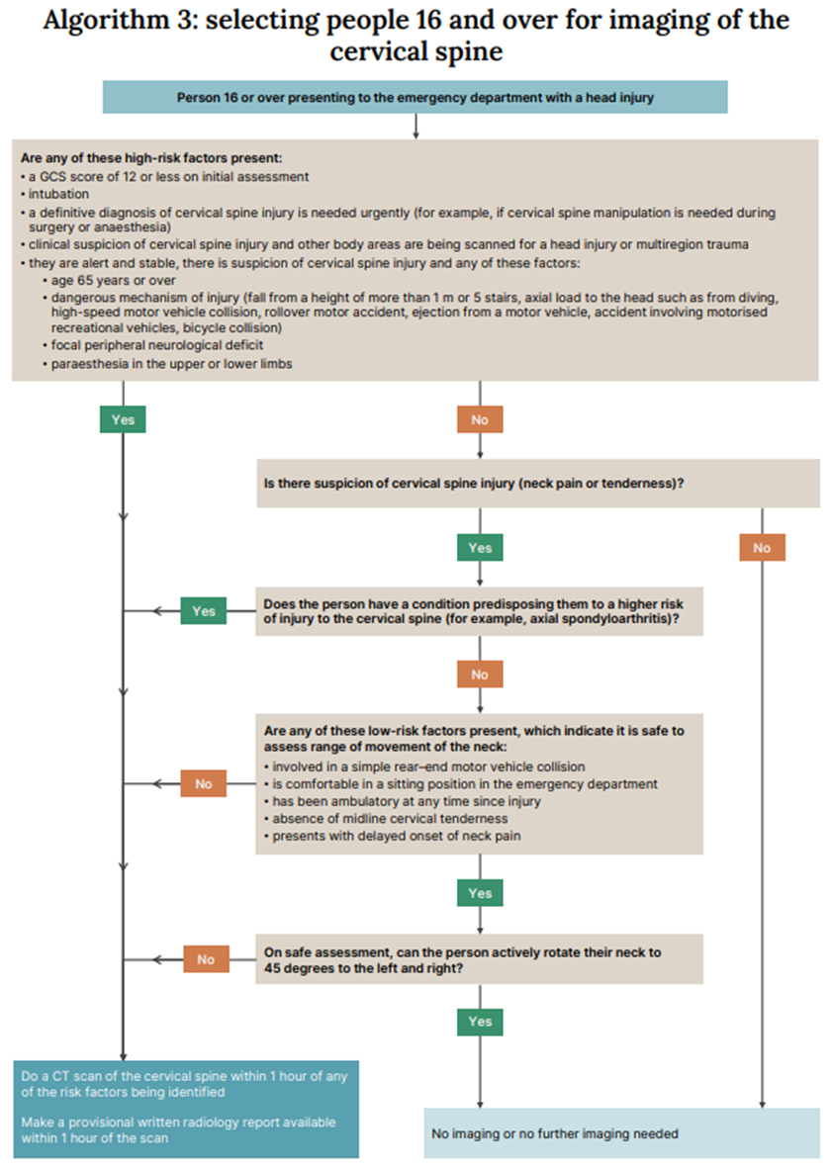
Algorithm detailing the need for CT Cervical Spine scan following a head injury for patients presenting to ED

Slide 24
Management
Management will depend upon the cause of the fall – manage any treatable precipitating factors that are identified
Neurological observations should be conducted in line with NICE guidelines
Ensure necessary documentation is completed – for inpatient falls ensure the IP Post-Fall Checklist is completed (see next slide)

Slide 25
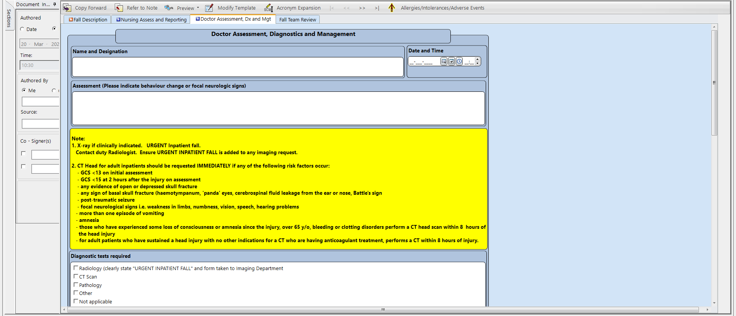

Slide 26
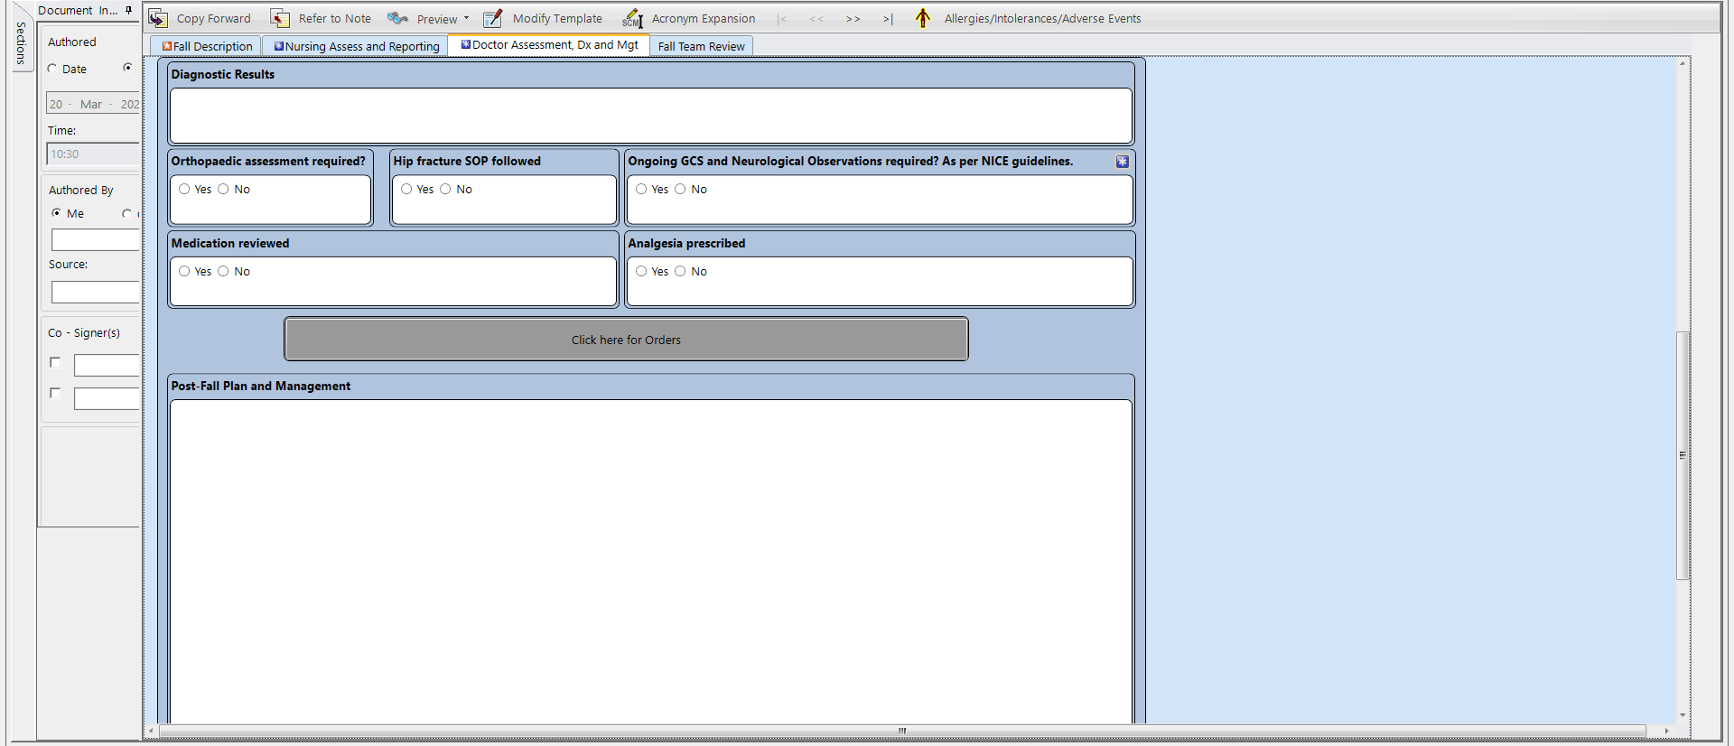

Slide 27
References
Falls - risk assessment | Health topics A to Z | CKS | NICE
Slips, Trips and Falls Handbook – available on trust intranet

